Slide 1
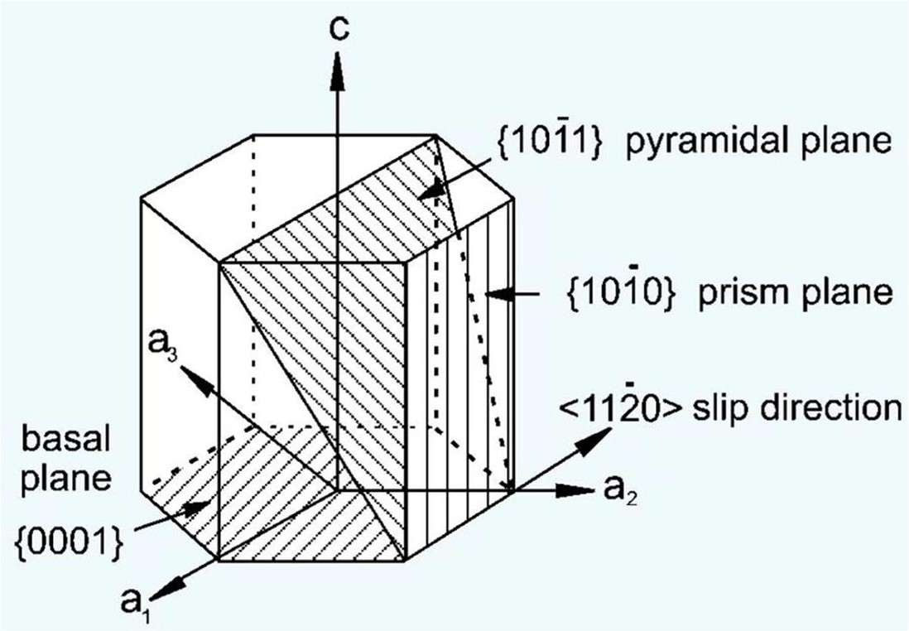

Slide 2
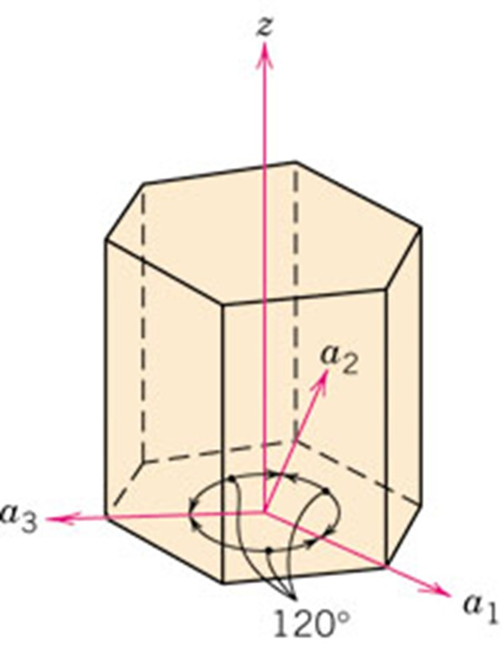
f07_03_pg54
Directions in Hexagonal Crystal
3-indices (Miller indices) and
4-indices (Miller–Bravais indices), coordinate system
Notes:
f07_03_pg54.jpg

Slide 3
Indexing of Crystallographic directions in hexagonal system
Four Index system:
Indexing algorithm is same as cubic system.
Take perpendicular projections on the axes
Three Index system:
Projections should be in hexagonal co-ordinate system reference frame

Slide 4
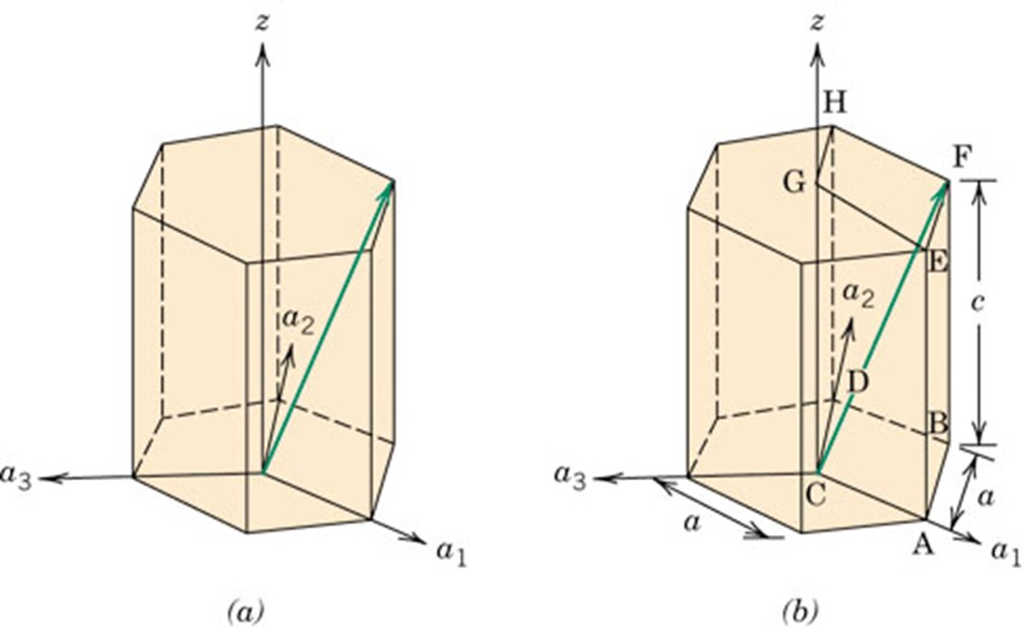
p_pg55
Finding perpendicular projections in Hexagonal crystal system is not always convenient
What is this direction CF?
In three index system: [1 1 1]
1 1 -2 3
Notes:
p_pg55.jpg

Slide 5
3 index to 4 index
Why we need 4 index system?
In 4 index system, Indices reveal crystallographically equivalent directions

Slide 6
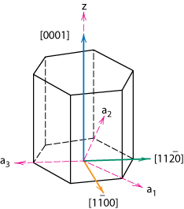
3 index (Miller indices) to 4 index (Miller-Bravais indices)
Hexagonal Crystals
4 parameter Miller-Bravais lattice coordinates are related to the direction indices (i.e., u'v'w') as follows.
z
[
u
'
v
'
w
'
]
→
[
uvtw
]
1
u
=
(
2
u
'
-
v
'
)
3
a₂
1
v
=
(
2
v
'
-
u
'
)
-
3
a₃
t
=
-
(
u
+
v
)
a₁
w
=
w
'

Slide 7

p_pg55
What is the index of the direction CE?
In Four index system:
1 1 -2 3
Notes:
p_pg55.jpg

Slide 8
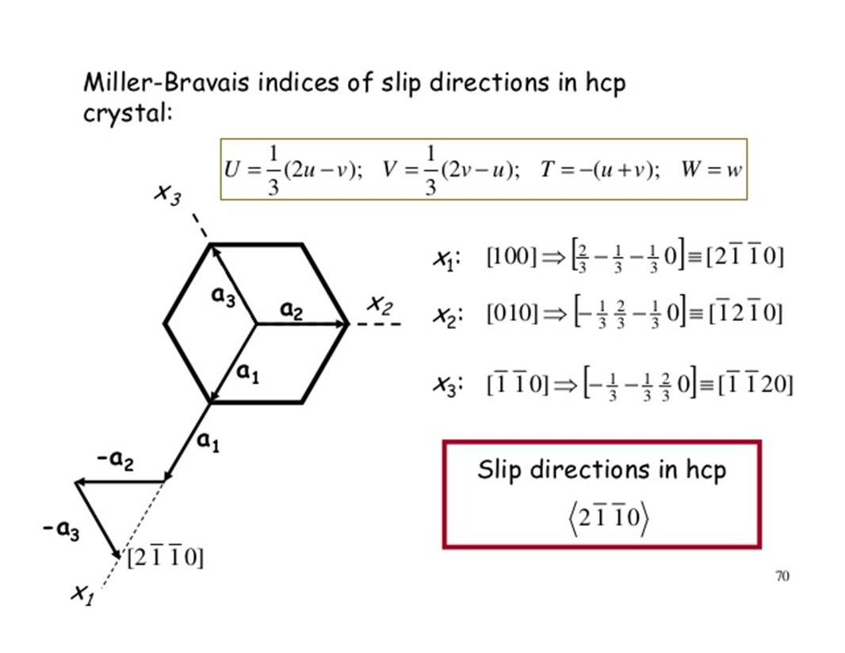

Slide 9
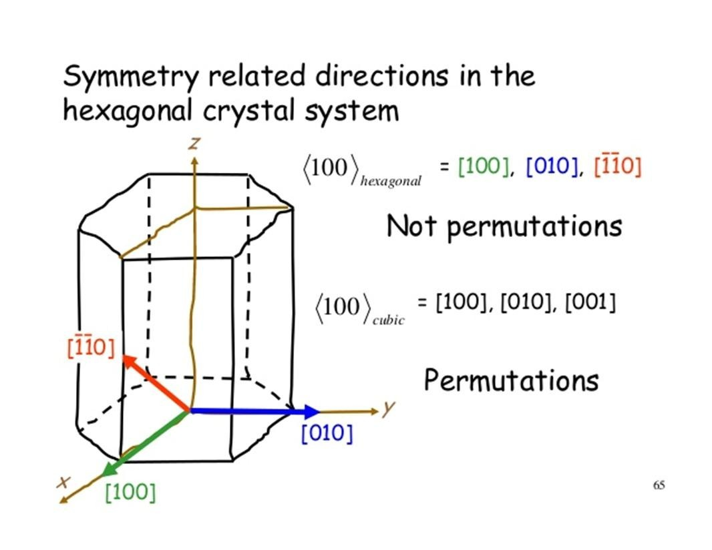

Slide 10
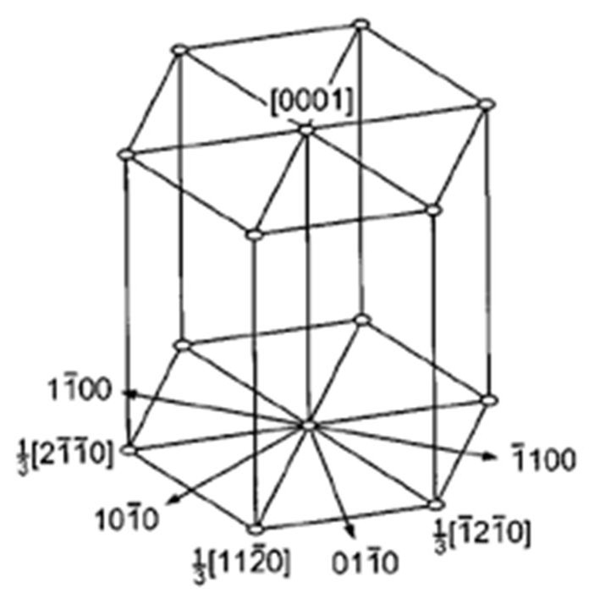

Slide 11
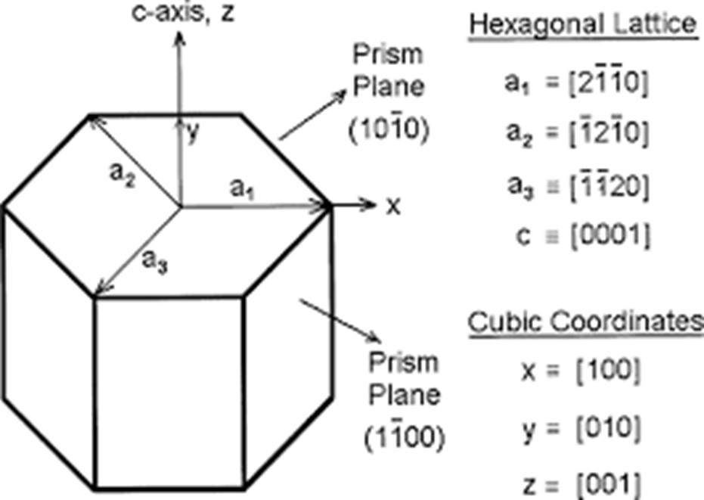

Slide 12
Bravais Lattices
Named after named after Auguste Bravais
Centering
7 Crystal Systems
14 Bravais Lattices
Primitive
Body Centering
Face Centering
Base Centering

Slide 13
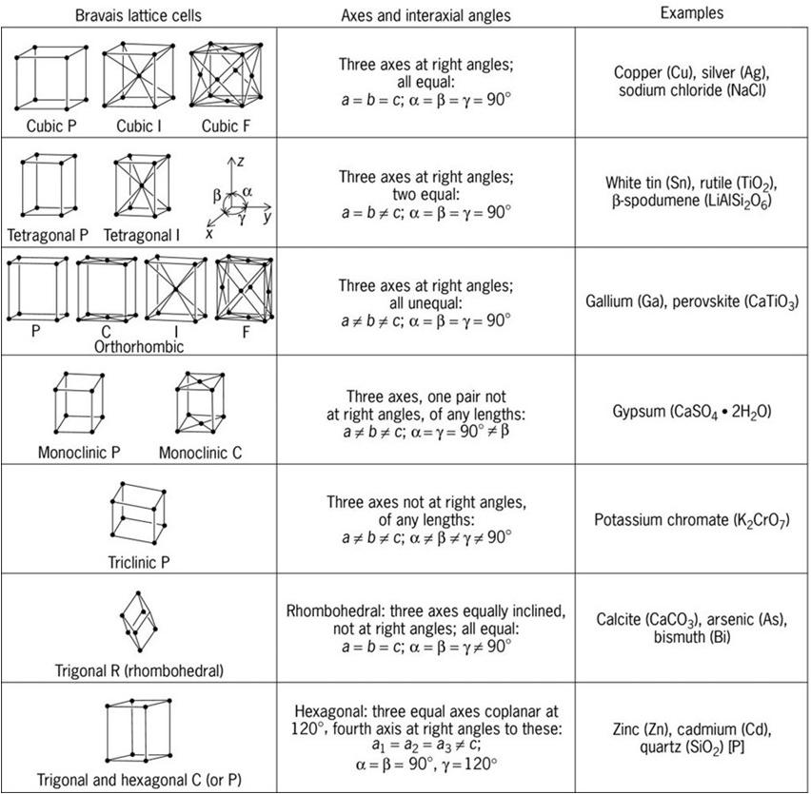

Slide 14
Bravais Lattices (14)

Slide 15
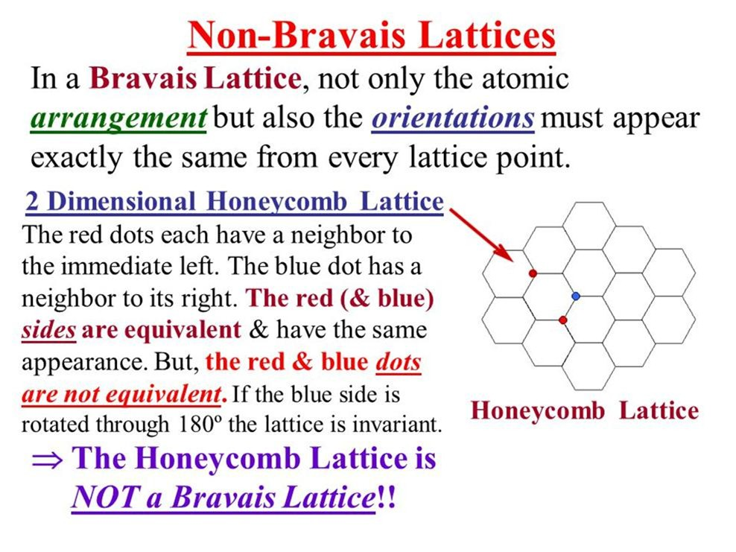

Slide 16
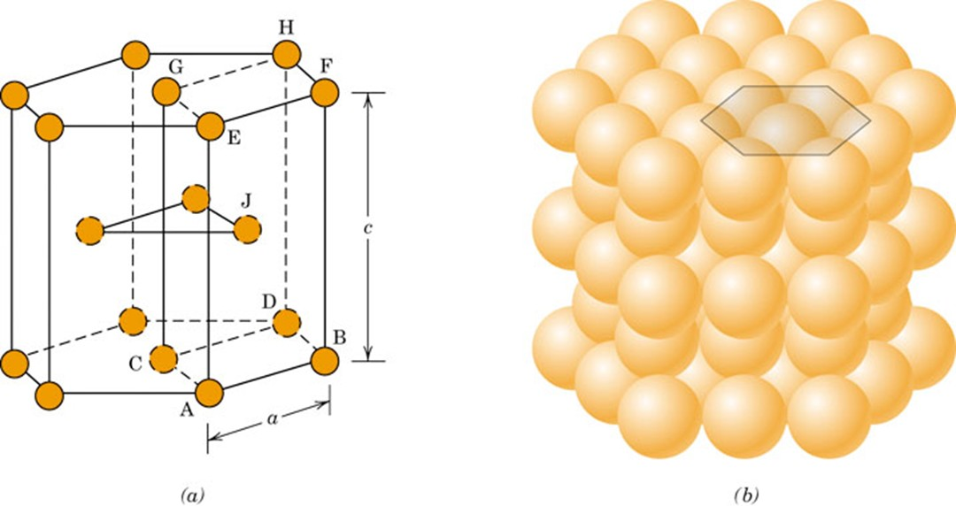
f03_03_pg43
HCP Structure
Hexagonal unit cell
Notes:
f03_03_pg43.jpg

Slide 17
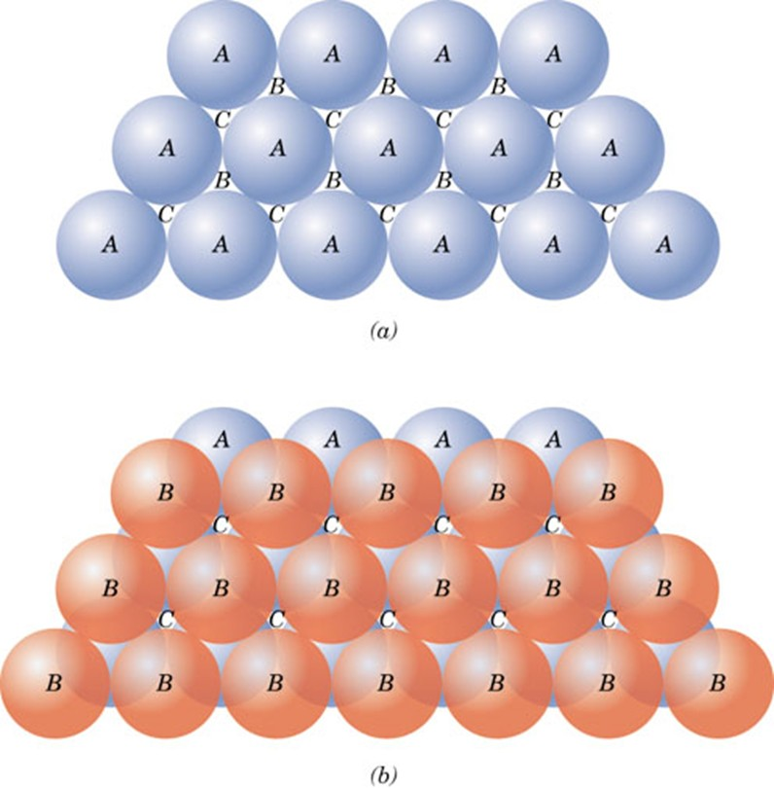
f13_03_pg62
Atomic layer arrangement
Notes:
f13_03_pg62.jpg

Slide 18
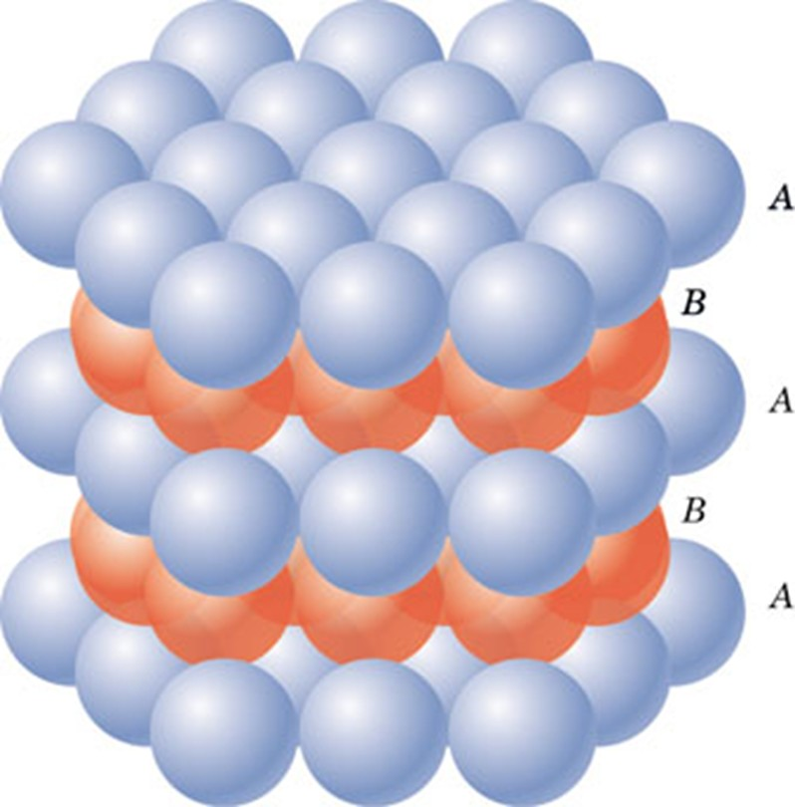
f14_03_pg62
Hexagonal packing
Notes:
f14_03_pg62.jpg

Slide 19
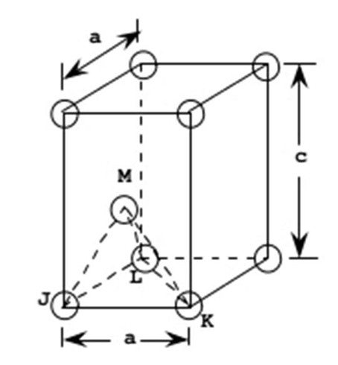
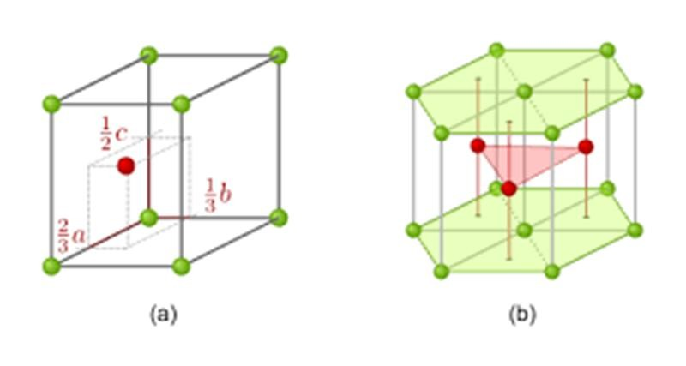
HCP

Slide 20
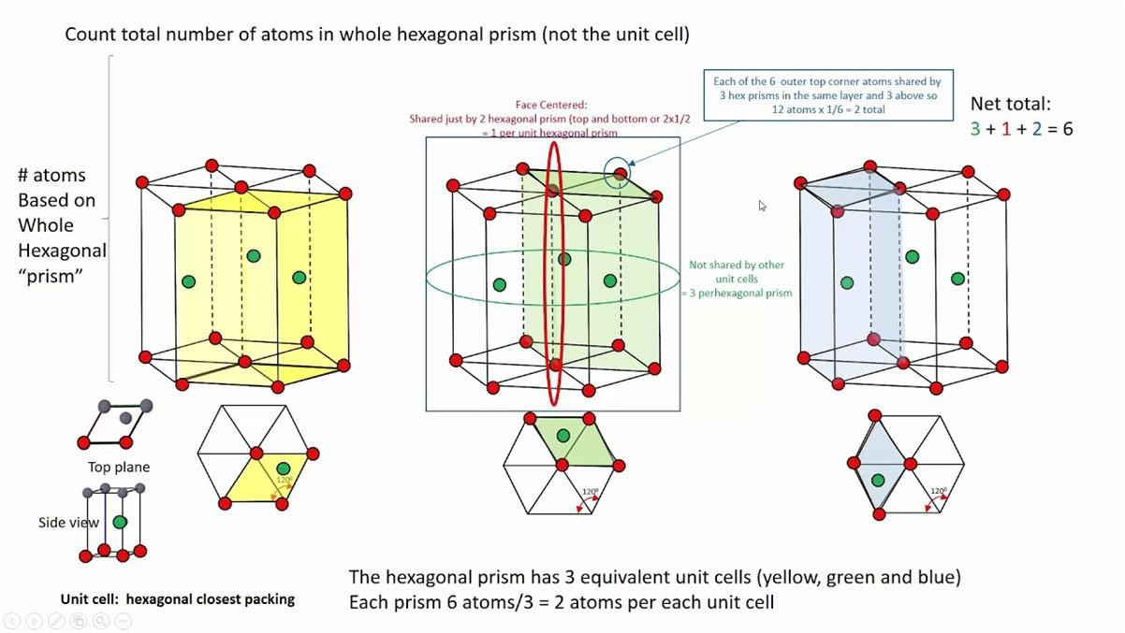

Slide 21
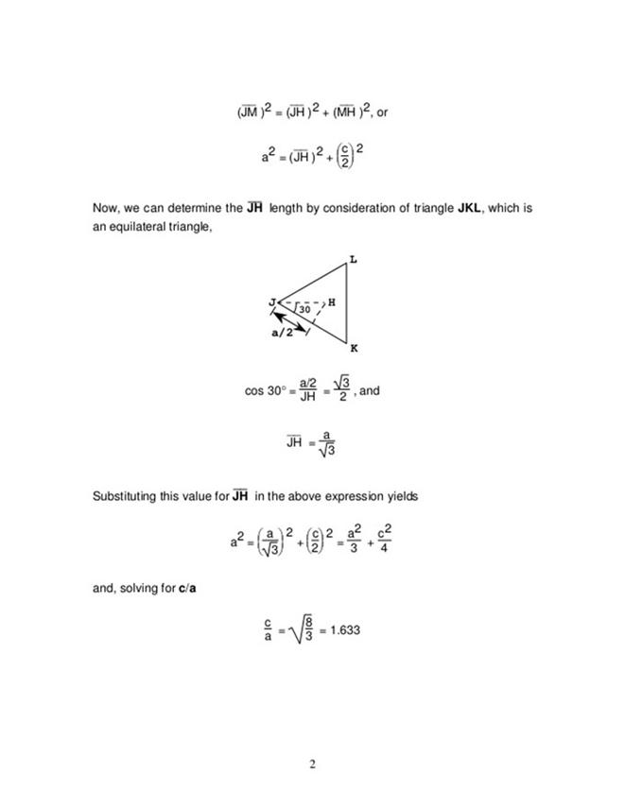
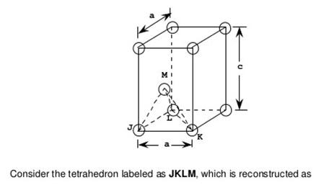
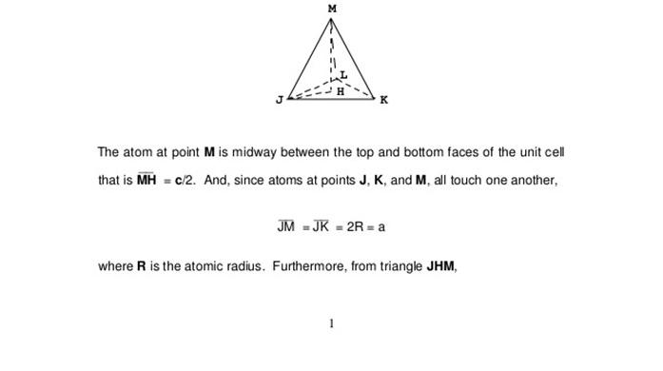
HCP : ideal c/a ratio is 1.633

Slide 22
Stacking Sequence
• ABCABC... Stacking Sequence
• 2D Projection
A
B
B
C
C
C
A
A
B
B
A sites
B
B
C
C
C
C
C
C
B
sites
B
B
C
sites
• FCC Unit Cell
A
B
C

Slide 23
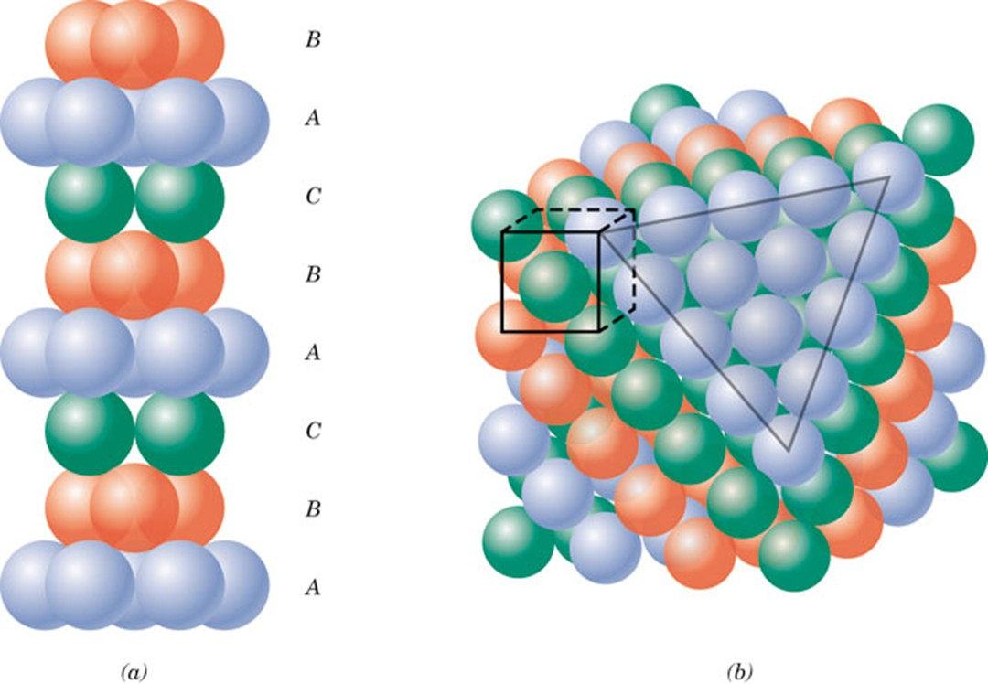
f15_03_pg63
Cubic closed packing
Notes:
f15_03_pg63.jpg

Slide 24
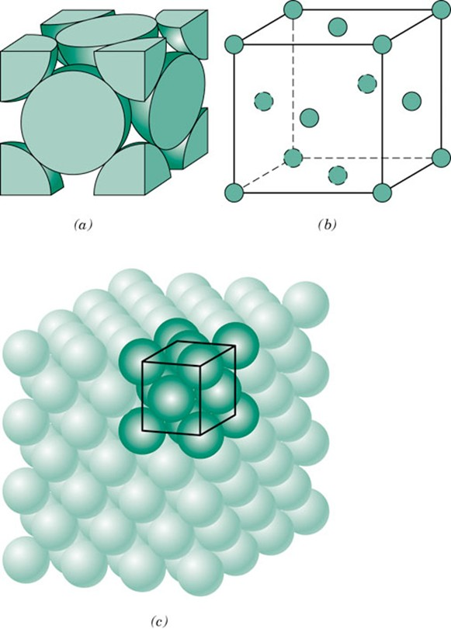
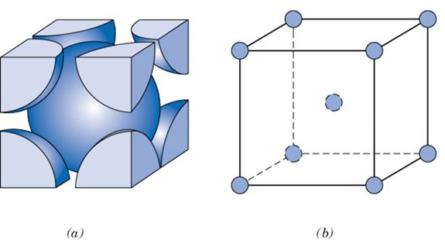
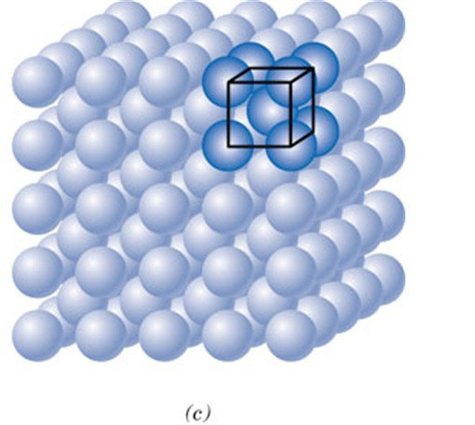
f01_03_pg40
FCC unit cell
BCC unit Cell
Notes:
f01_03_pg40.jpg

Slide 25
http://www.chemtube3d.com/solidstate/_table.htm

Slide 26
Atoms Per Unit Cell
Corners - shared by eight unit cells (x 1/8)
Edges - shared by four unit cells (x 1/4)
Faces - shared by two unit cells (x 1/2)

Slide 27
Common Metal Structures
Face-Centered Cubic (FCC)
8 corners x 1/8 + 6 faces x 1/2
1 + 3 = 4 atoms/u.c.
Body-Centered Cubic (BCC)
8 corners x 1/8 + 1 center
1 + 1 = 2 atoms/u.c.
Hexagonal Close-Packed (HCP)
4 corners x 1/6 + 4 corners x 1/12 + 1 middle
2/3 +1/3 + 1 = 2 atoms/u.c.

Slide 28
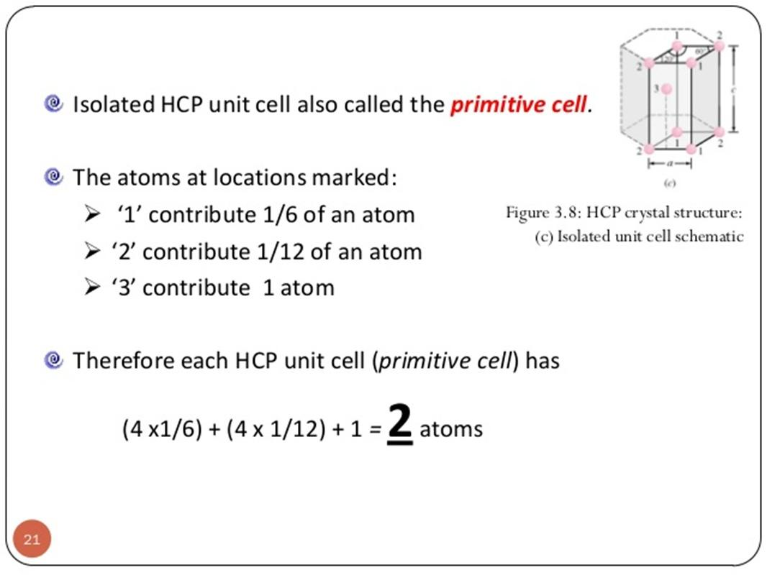

Slide 29
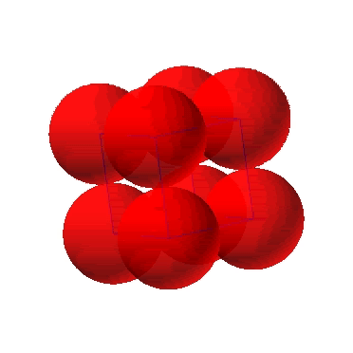
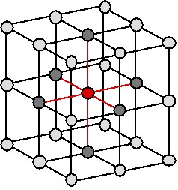
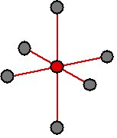
Simple Cubic Structure (SC)
• Rare due to low packing density (only Po has this structure)
• Close-packed directions are cube edges.
• Coordination # = 6
(# nearest neighbors)

Slide 30
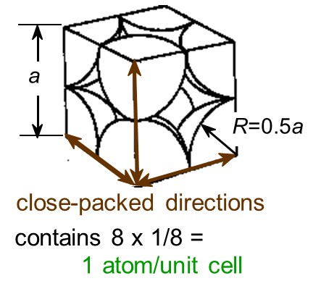
Atomic Packing Factor (APF)
Volume of atoms in unit cell*
APF =
Volume of unit cell
*assume hard spheres
• APF for a simple cubic structure = 0.52
volume
atoms
atom
4
3
unit cell
1
π
(0.5a)
3
APF =
a
3
volume
unit cell

Slide 31
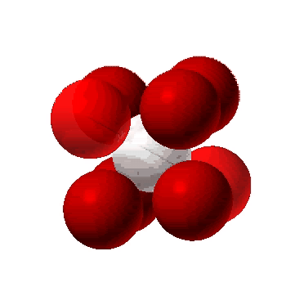
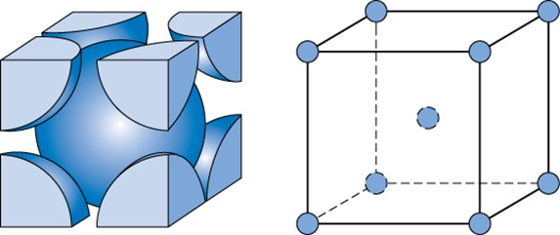
Body Centered Cubic Structure (BCC)
• Atoms touch each other along cube diagonals.
--Note: All atoms are identical; the center atom is shaded
differently only for ease of viewing.
ex: Cr, W, Fe (α), Tantalum, Molybdenum
• Coordination # = 8
2 atoms/unit cell: 1 center + 8 corners x 1/8

Slide 32
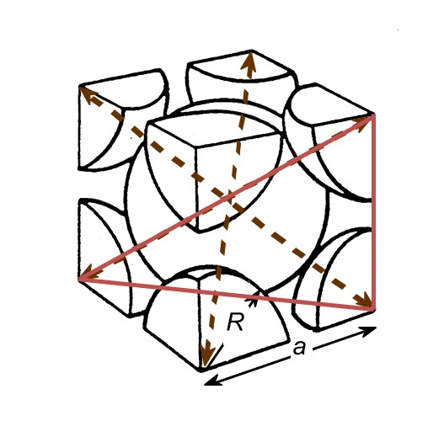
Atomic Packing Factor: BCC
• APF for a body-centered cubic structure = 0.68
3
a
a
2
a
Close-packed directions:
length = 4R =
3 a
atoms
volume
4
3
unit cell
2
π
(
3
a/4
)
3
atom
APF =
3
volume
a
unit cell

Slide 33
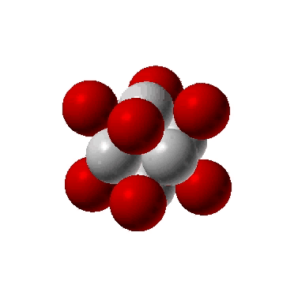
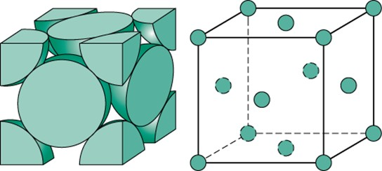
Face Centered Cubic Structure (FCC)
• Atoms touch each other along face diagonals.
--Note: All atoms are identical; the face-centered atoms are shaded
differently only for ease of viewing.
ex: Al, Cu, Au, Pb, Ni, Pt, Ag
• Coordination # = 12
4 atoms/unit cell: 6 face x 1/2 + 8 corners x 1/8

Slide 34
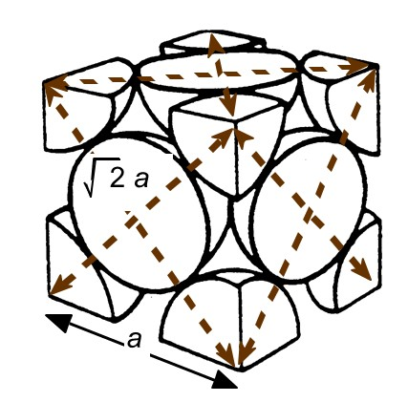
Atomic Packing Factor: FCC
• APF for a face-centered cubic structure = 0.74
maximum achievable APF
Close-packed directions:
length = 4R =
2 a
Unit cell contains:
6 x 1/2 + 8 x 1/8
=
4 atoms/unit cell
atoms
volume
4
3
unit cell
4
π
(
2
a/4
)
3
atom
APF =
3
volume
a
unit cell

Slide 35
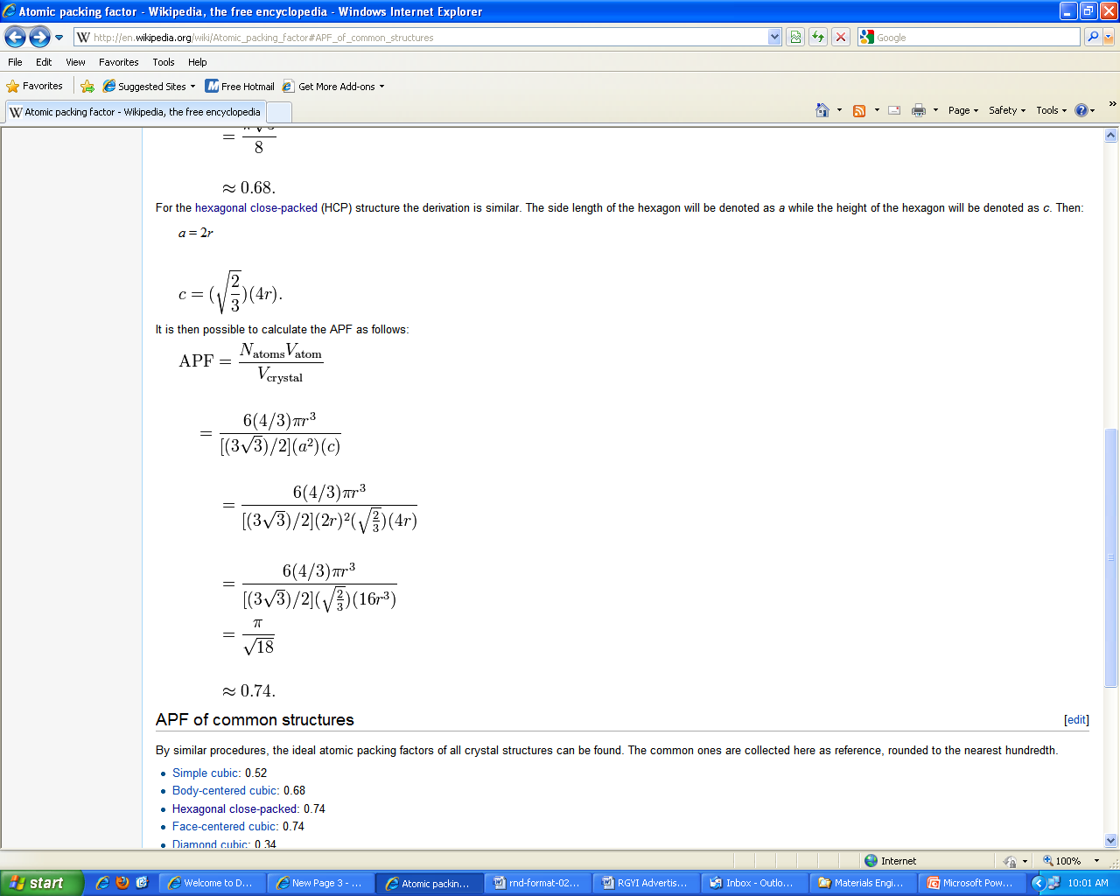
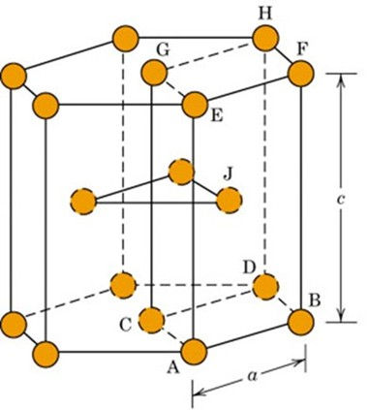
Atomic Packing Factor: HCP
atoms
volume
Close-packed directions:
4
3
length = 2R =
a
unit cell
2
π
(
R
)
3
atom
c/a =( 8/3 )
APF =
2
volume
3/2 a c
Unit cell contains:
unit cell
4 x 1/(3 x 2) + 4 x 1/(6 x 2) + 1
=
2 atoms/unit cell

Slide 36
Theoretical Density, ρ
Mass
of
Atoms
in
Unit
Cell
Density = ρ =
Total
Volume
of
Unit
Cell
n A
ρ =
V_{C} N_{A}
where n = number of atoms/unit cell
A = atomic weight
V_{C} = Volume of unit cell = a³ for cubic
N_{A} = Avogadro’s number
= 6.023 x 10²³ atoms/mol

Slide 37
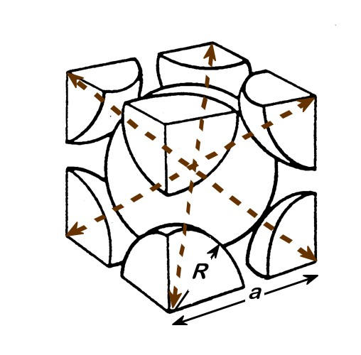
Theoretical Density, ρ
Ex: Cr (BCC)
A = 52.00 g/mol
R = 0.125 nm
n = 2
a = 4R/ 3 = 0.2887 nm
atoms
g
unit cell
2
52.00
ρ_{theoretical}
mol
= 7.18 g/cm³
ρ =
ρ_{actual}
= 7.19 g/cm³
a
3
6.023 x 10²³
volume
atoms
unit cell
mol

Slide 38
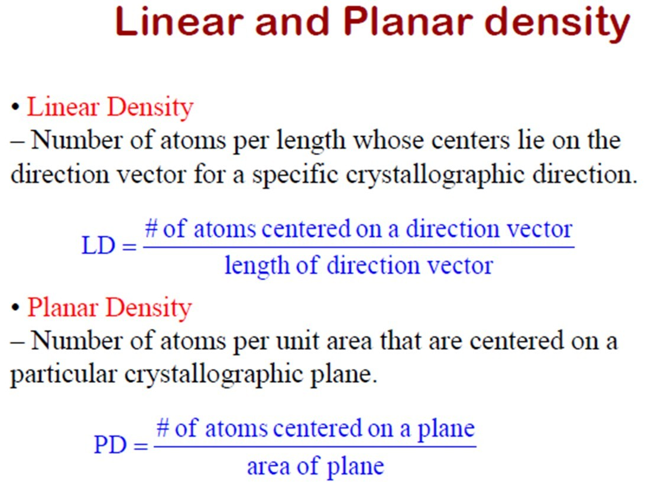

Slide 39
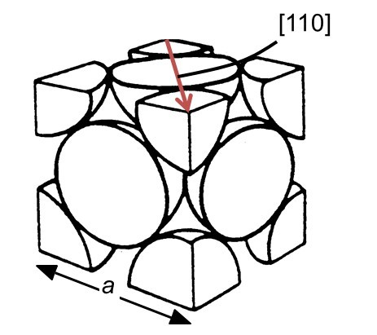
Linear Density
Linear Density of Atoms ≡ LD =
Number of atoms
Unit length of direction vector
ex: linear density of Al in [110] direction a = 0.405 nm
# atoms
2
LD
=
=
3.5 nm
−
1
2
a
length

Slide 40
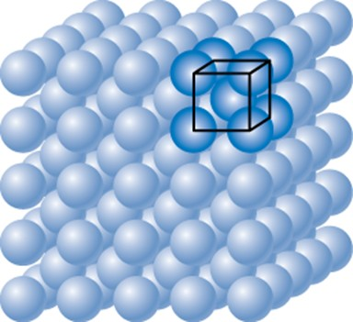
Planar Density of (100) Iron
At T < 912°C iron has the BCC structure.
2D repeat unit
(100)
4
3
a
=
R
3
Radius of iron R = 0.1241 nm
atoms
2D repeat unit
1
1
atoms
atoms
Planar Density =
=
2
=
12.1
= 1.2 x 10¹⁹
a
2
4
3
nm²
m²
area
R
2D repeat unit
3

Slide 41
Planar Density of (111) Iron
Solution (cont): (111) plane
1 atom in plane/ unit surface cell
2
a
atoms in plane
atoms above plane
atoms below plane
2D repeat unit
3
h
=
a
2
⎛
4
3
⎞
2
16
3
area
=
2
ah
=
3
a
2
=
3
⎜
R
⎟
=
R
2
⎜
3
⎟
3
atoms
⎝
⎠
2D repeat unit
1
Planar Density =
atoms
=
atoms
=
7.0
0.70 x 10¹⁹
area
16
3
nm²
m²
R
2
2D repeat unit
3

Slide 42
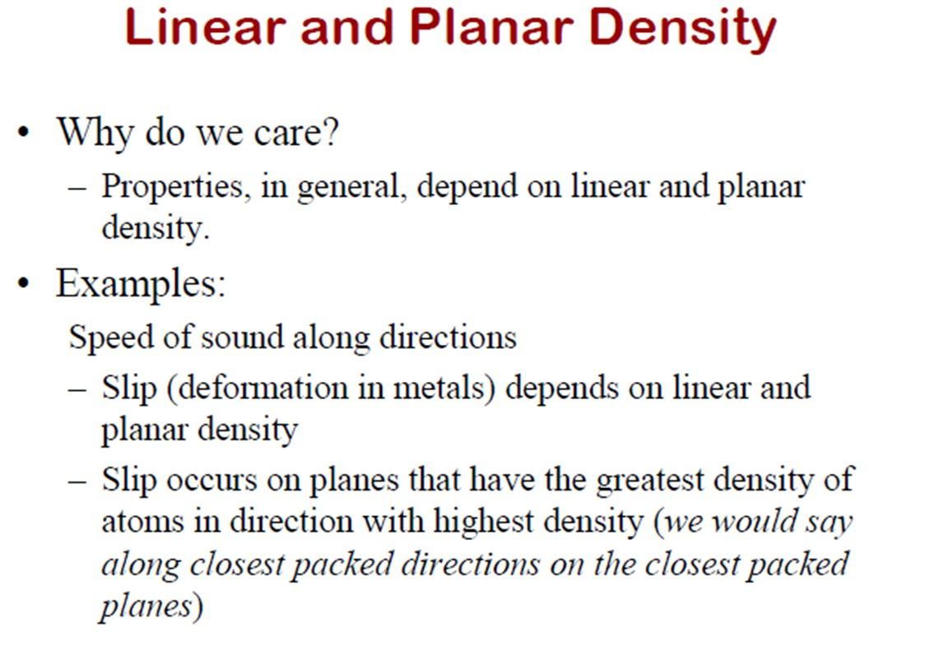

Slide 43
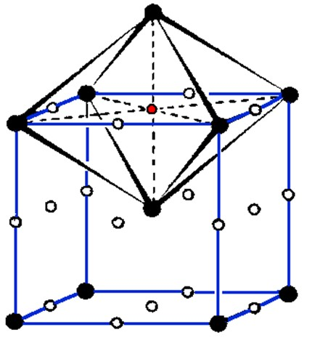
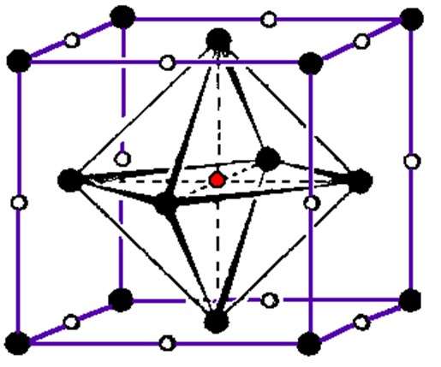
Octahedral interstitial sites
The space in the interstices between 6 regular atoms that form an octahedron.
Four regular atoms are positioned in a plane, the other two are in a symmetrical position just above or below.
FCC
BCC
12/4 + 6/2 = 6 positions per unit cell
12/4 +1 = 4 positions per unit cell

Slide 44
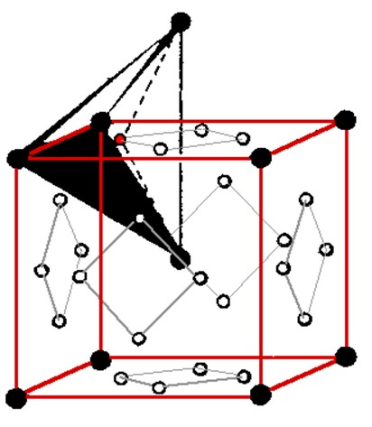
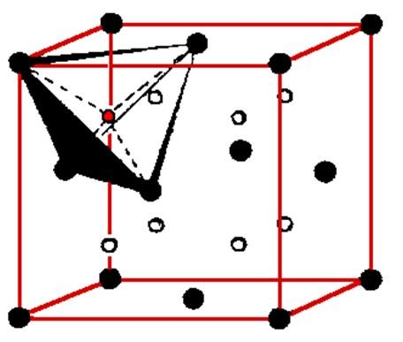
Tetrahedral interstitial sites
The center of a tetrahedra formed by four lattice atoms.
Three atoms, touching each other, are in plane; the fourth atom sits in the symmetrical position on top.
FCC
BCC
(6 · 4)/2 = 12 positions per unit cell
8 positions per unit cell

